Slide 1

CAPSTONE PROJECT KEYLOGGER AND SECURITY
Presented by,
Name : A.SWETHA
College : UCET Dept: CSE

Slide 2
OUTLINE:
Introduction to keyloggers
What is keylogger?
Definition of keyloggers
Types of keyloggers
Software keyloggers
Hardware keyloggers
Role of keyloggers
Keyloggers Architecture
Example of keyloggers
Problem Statement For keyloggers
Use Case Diagram
Advantages
Drawbacks
Conclusion

Slide 3

INTRODUCTION TO KEYLOGGERS:
The first computer Keylogger was developed by then-graduate student Perry Kollwitz in 1983 as a proof of concept. One particularly noteworthy example of a keylogger “in the wild ” was distributed with a Grand Theft Auto V mod in 2015.

Slide 4
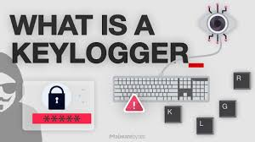
WHAT IS KEYLOGGER?
Keyloggers also known as Keystroke loggers, may be defined as the recording of the key pressed on a system and saved it to a file, and the person using this malware. Keylogger can be software or can be hardware.

Slide 5
DEFINITION OF KEYLOGGERS:
A Keylogger or Keystroke logger/Keyboard capturing is a form of malware or hardware that keeps track of and records your Keystrokes as you type. It takes the information and sends it to a hacker using a command-and-control(C&C) server.

Slide 6
WHERE SHOULD THIS KEYLOGGER BE USED?
Parental Monitoring
Employee Monitoring
Law Enforcement and Investigations

Slide 7
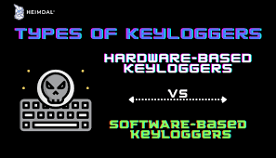
TYPES OF KEYLOGGERS:
A software Keylogger is a form of malware that infects your device and , if programmed to do so, can spread to other devices the computer comes in contact.
There are Two Common Types.
They are,
Software Keylogger
Hardware Keylogger

Slide 8
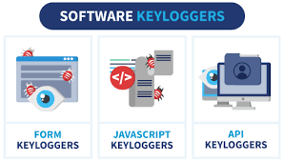
SOFTWARE KEYLOGGERS:
Software Keyloggers consist of applications that have to be installed on a computer to steal keystroke data. They are the most common method hackers use to access a user’s keystrokes.

Slide 9
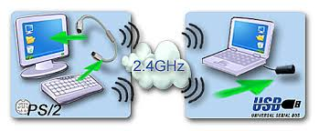
HARDWARE KEYLOGGERS:
A hardware Keylogger works much like its software counterpart. The biggest difference is hardware key loggers have to be physically connected to the target computer to record the user’s keystrokes. For this reason, it is important for an organization to carefully monitor who has access to the network and the devices connected to it.

Slide 10
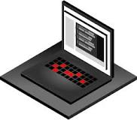
ROLE OF KEYLOGGERS:
Keyloggers are a type of malware that is downloaded onto a device through an entry point. Entry points can be infected software, emails, files or cloud programs. When keylogging software gets installed on a victim’s device, it logs every keystroke to gather login credentials and other sensitive information.

Slide 11
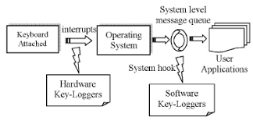
KEYLOGGERS ARCHITECTURE:

Slide 12

EXAMPLE OF KEYLOGGERS:
A keylogger is an example of Spyware.

Slide 13
PROBLEM STATEMENT FOR KEYLOGGERS:
Problem Statement – It’s Challenging to covertly install a hardware keylogger on another person’s device. To tackle this issue, We are therefore using a software keylogger that can be remotely installed on a person’s PC to resolve this problem.

Slide 14
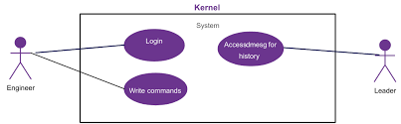
USE CASE DIAGRAM:

Slide 15

ADVANTAGES:
Full Transparency.
More Productivity.
Clearer Understanding Of
Performance.
Less Risk of Data Theft.
Better Password Access.
Tougher Deterrent Against Phishing and Viruses.

Slide 16

DRAWBACKS:
Often flagged by antimalware software as malicious.
Incapable of logging BIOS inputs.

Slide 17
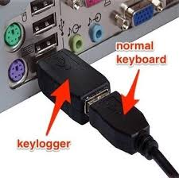
CONCLUSION:
Keyloggers are a potent threat to both individuals and enterprises, with the potential to cause significant harm if left undetected. Understanding the nature of keyloggers, their methods of infiltration , and the dangers they pose is crucial for maintaining a secure digital environment.

Slide 18
THANK YOU

